Slide 1
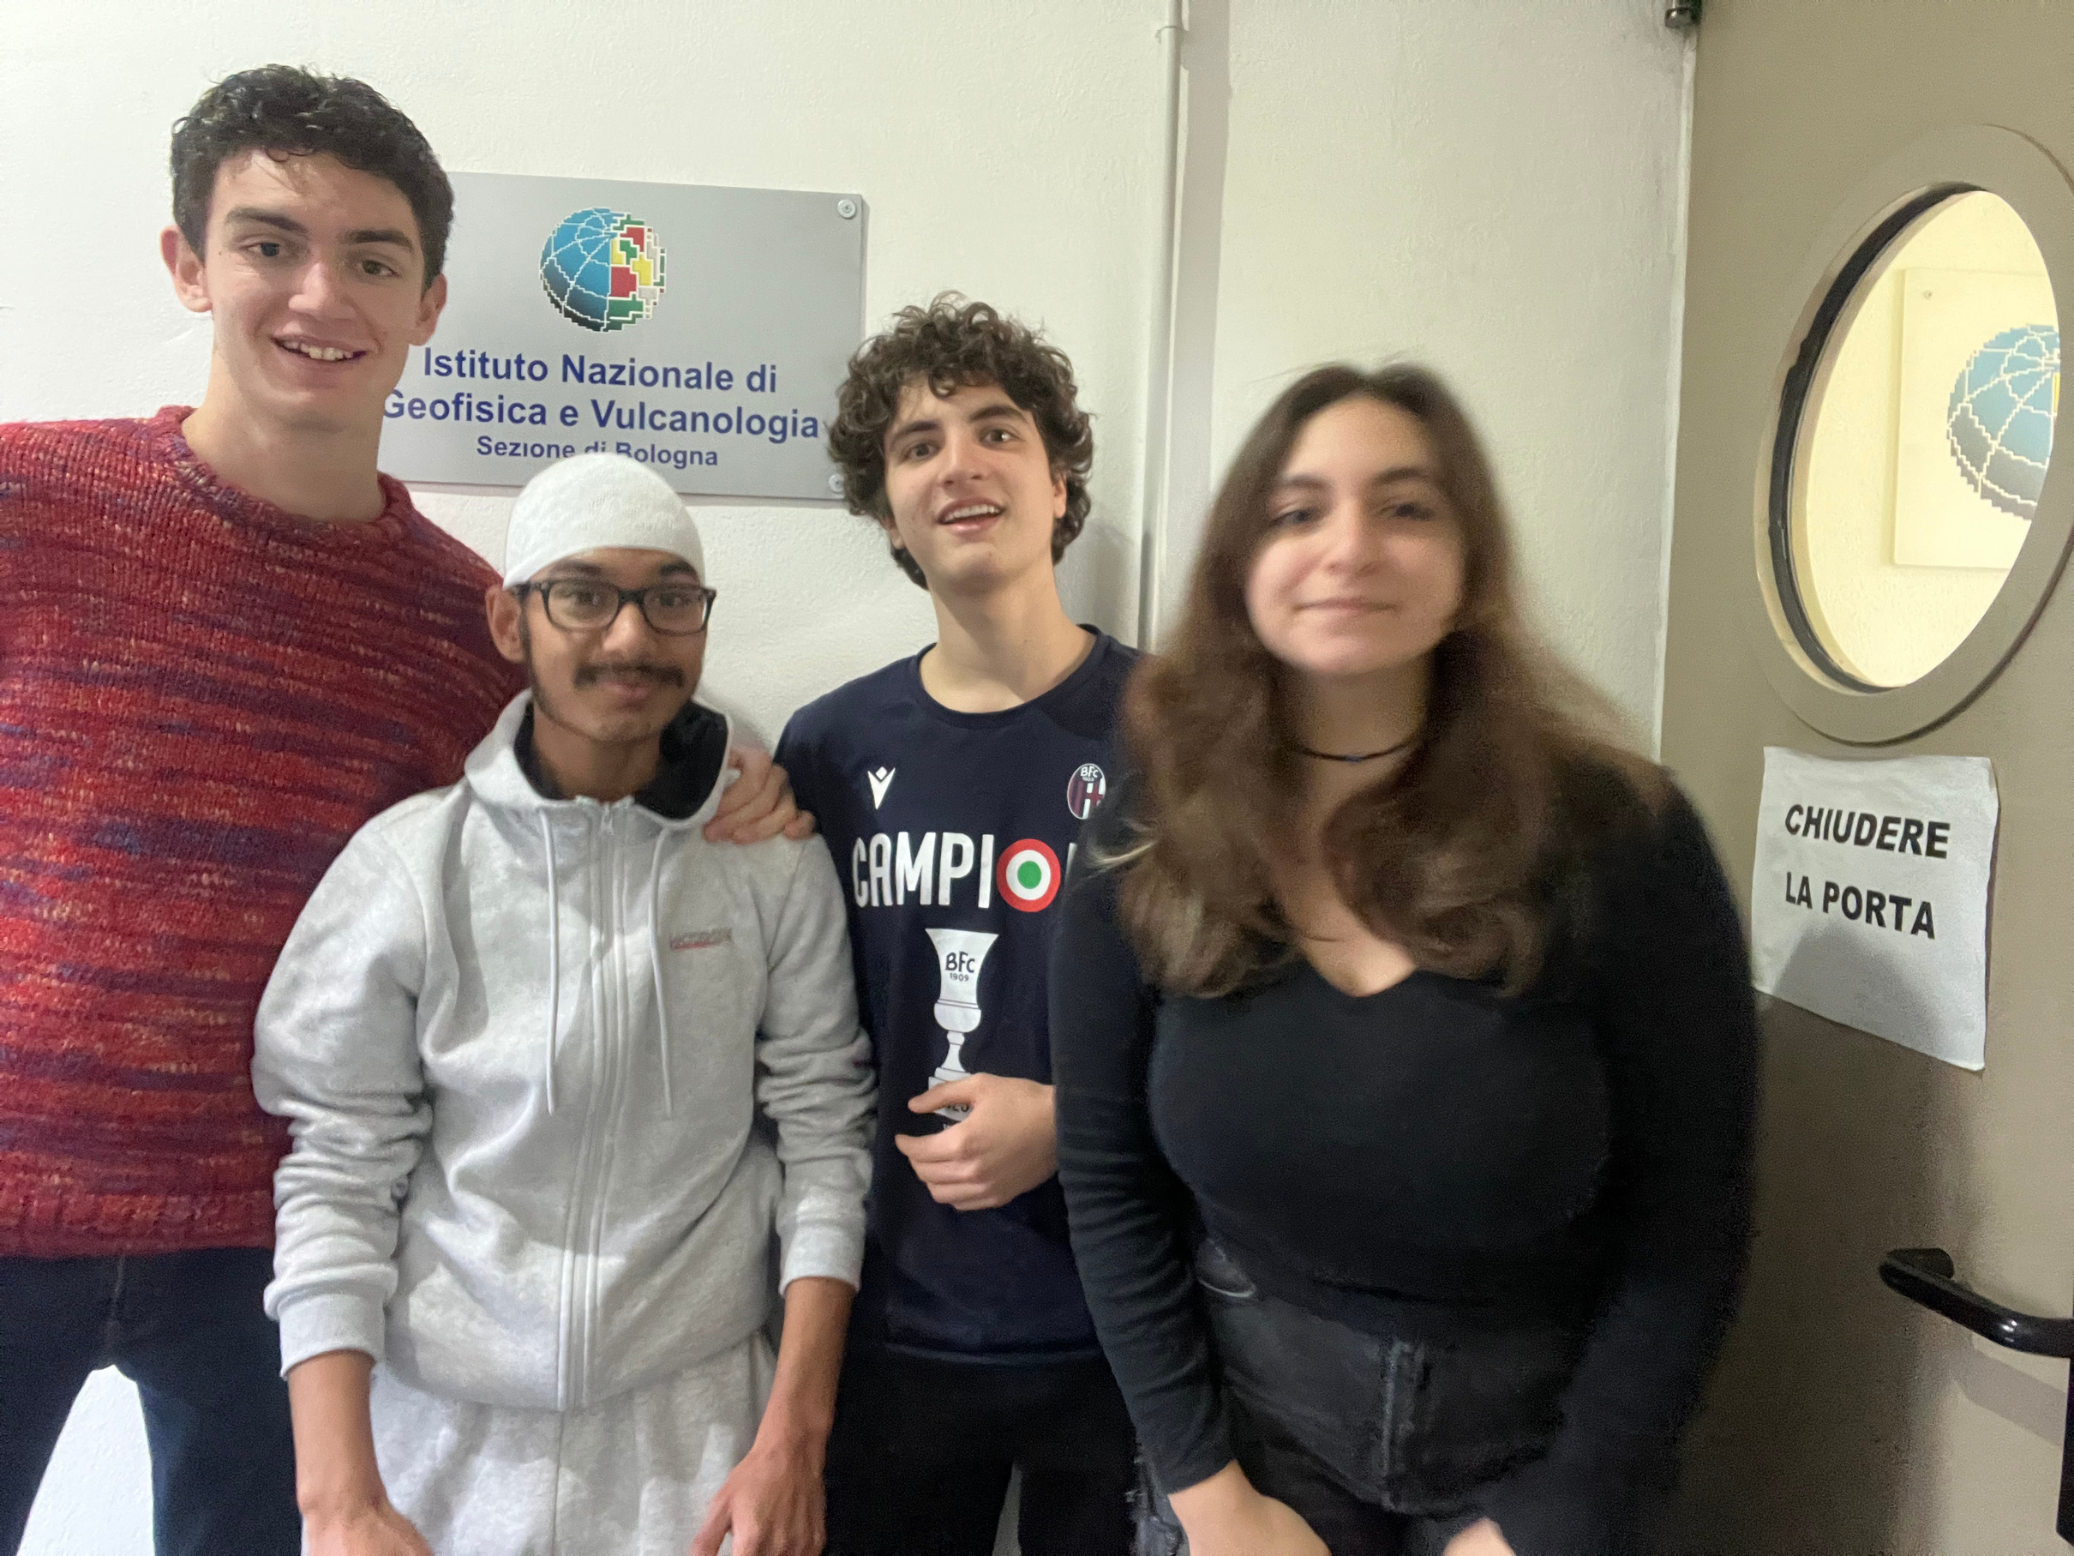






Matteo Galdini
My month
at
INGV
and my FSL experience
https://www.bo.ingv.it/

Slide 2


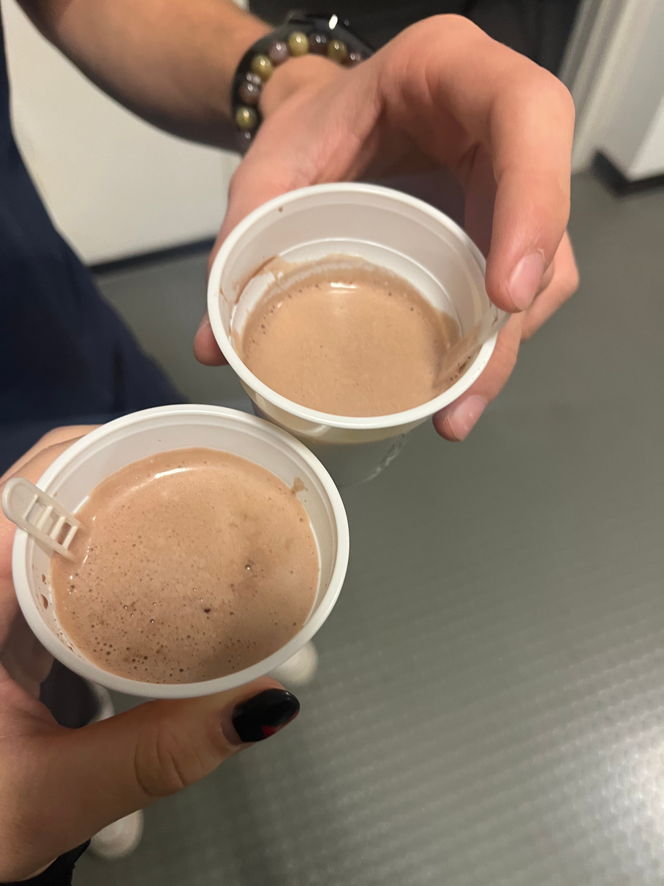

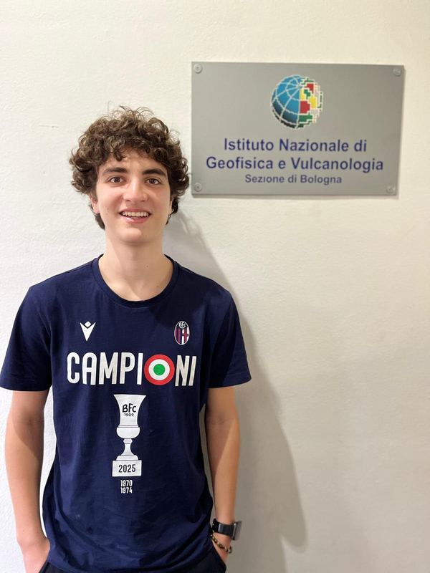


Matteo Galdini
About me
I’m Matteo Galdini, i’m an Aldini student currently attending what i hope will be my last high-school year.
I spend my free time playing videogames, watching sports and practising my tennis skills.
From this experience I expected to work with python among with developing my working skills.
My goal was to be productive for the company, while on the same hand developing soft skills in order to work better in the future.

Slide 3





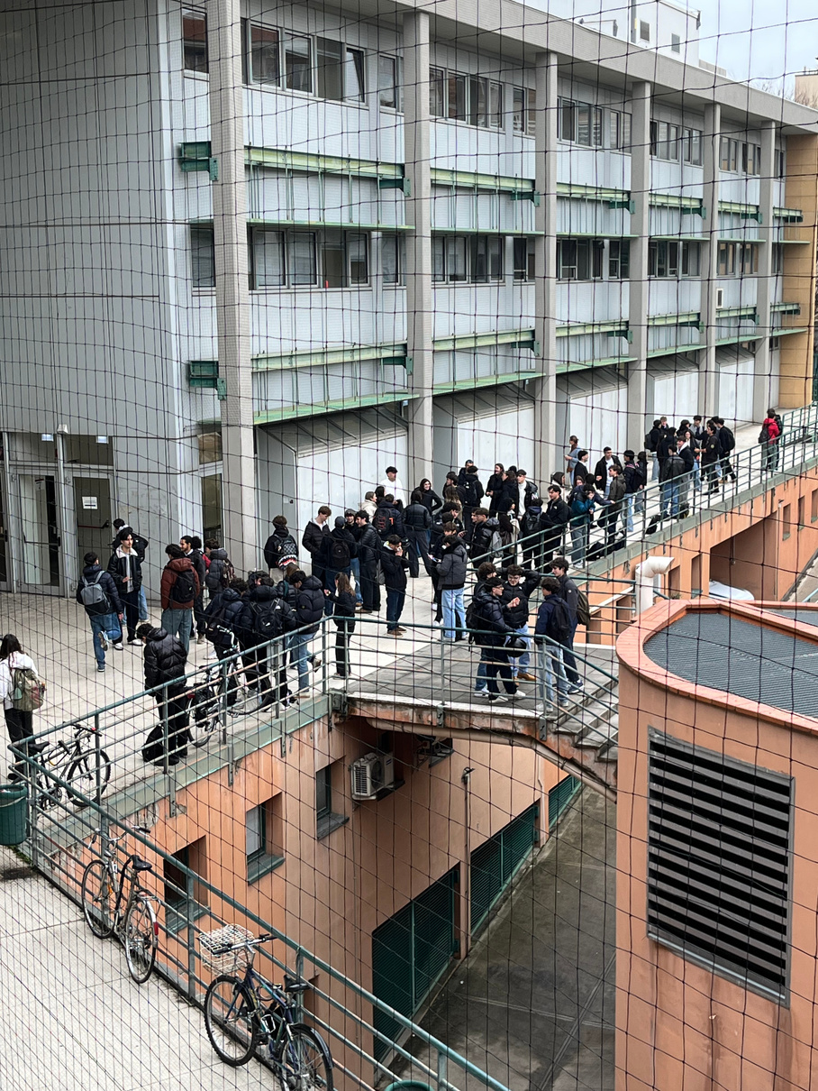

Matteo Galdini
Host
Overview
INGV
Where?
Viale Carlo Berti Pichat, 6/2
When?
from 24/11 to 19/12
What?
Environment
Who?
Alessandra Borghi
Why?
Close to my house
951

Slide 4

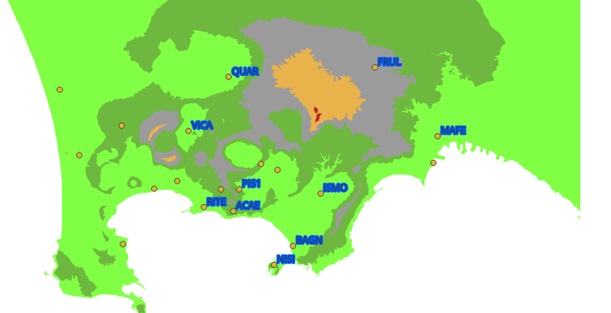
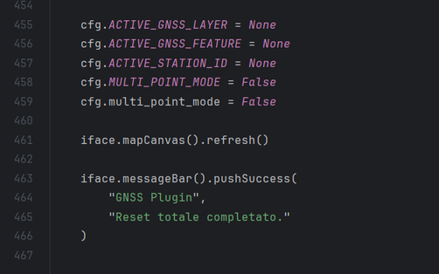




Matteo Galdini
My
Role
Learning & reporting
Coding & debugging
GNSS Interactive Plugin
We learned how to use the software Qgis
We used the QGIS python console in order to make a functional code
We transformed our work into a useful QGIS type plugin

Slide 5
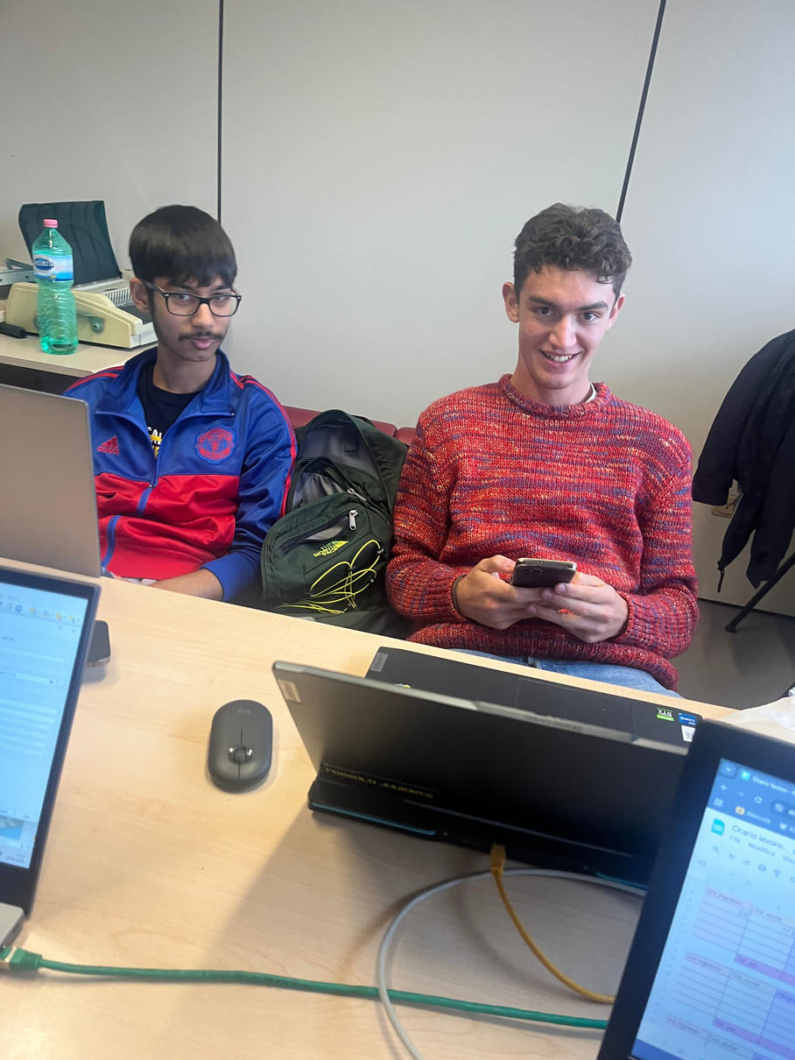
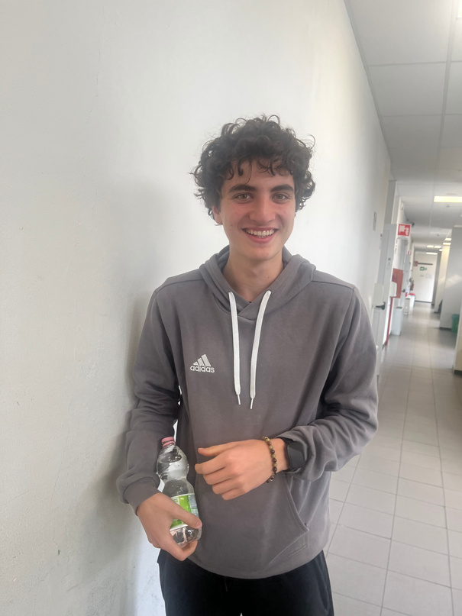
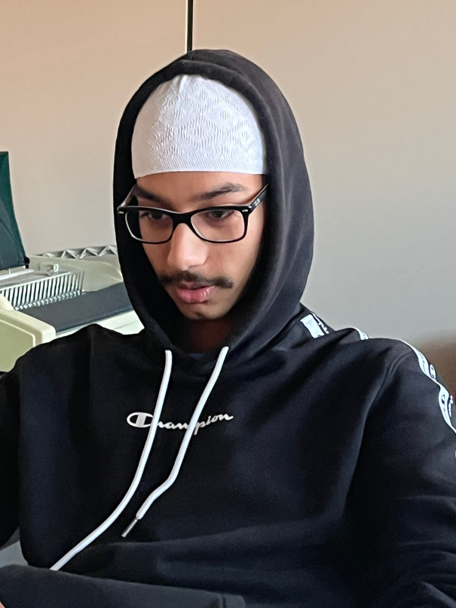
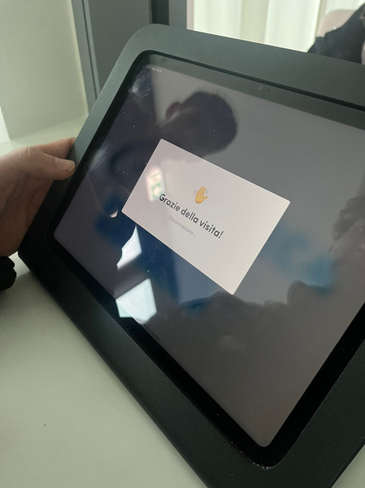
Matteo Galdini
Week
Breakdown
Week 1
Week 2
Week 3
Week 4
24/11 → 29/11
1/12 → 5/12
8/12 → 12/12
15/12 → 19/12
Orientation and theorical skills
Development of python skills
Development of Qgis skills
Last updates, work trip and plugin

Slide 6


Matteo Galdini
Skills
Python skills
Qgis skills
Developed
While working on the code, we improved our python skills and discovered new libraries
We can now use the softare given to us properly and we also made a tutorial
Adaptability &
critical thinking
Comunication & teamwork
We had to adapt the code to the specific functionalites of the software
We had to report what we were doing on a daily basis, we had to collaborate and speak
We had to agree on the coffe break

Slide 7


Matteo Galdini
Challenges
We had to understand what they were really asking
Requests
Testing
Reporting
“Chat gpt why isn’t this working?”
We had to report our progresses properly

Slide 8


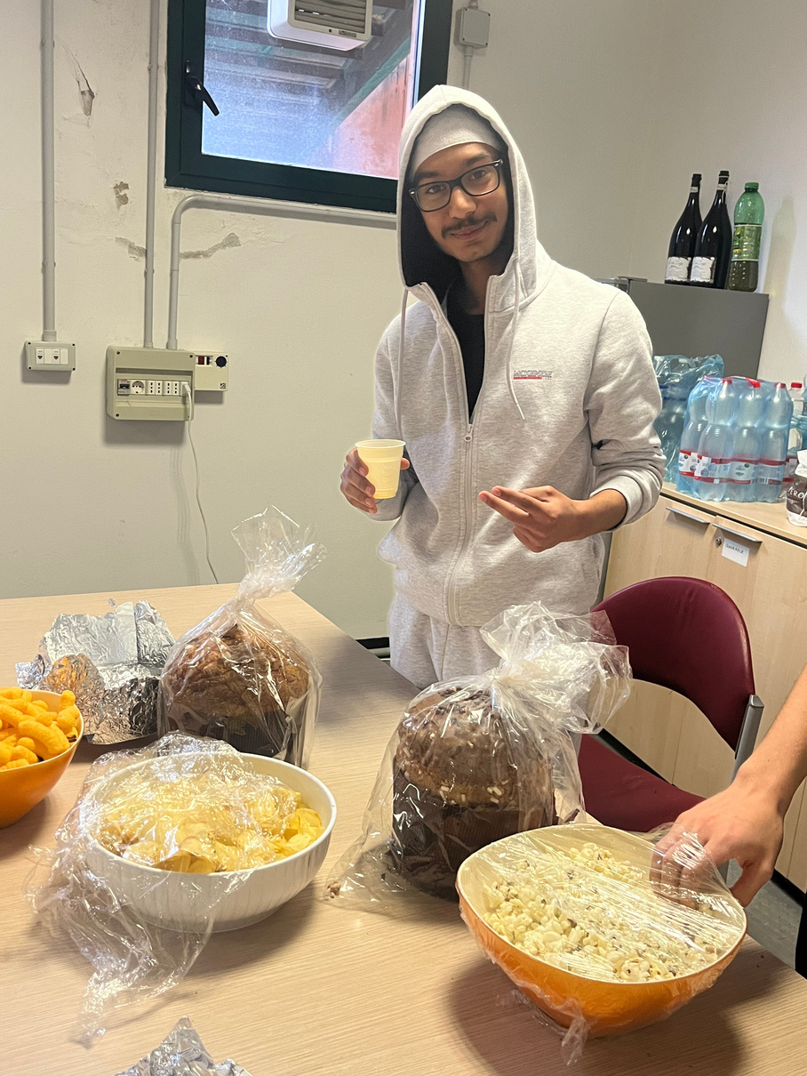

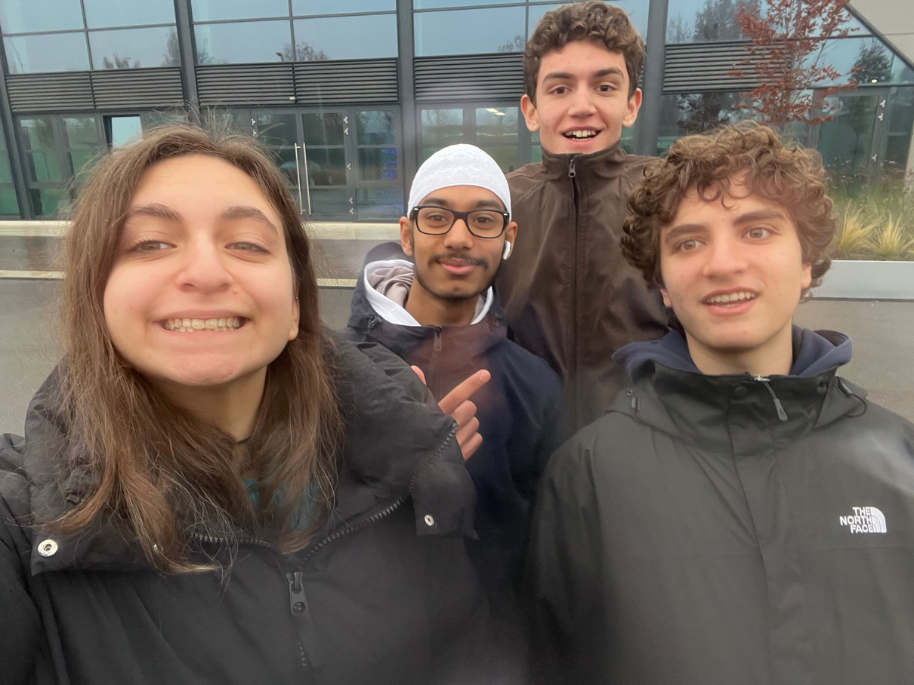
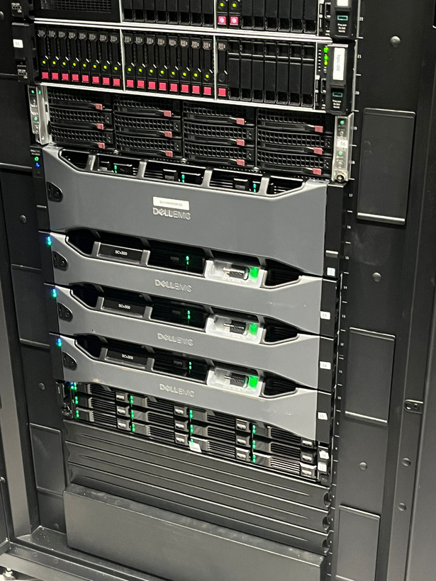
Matteo Galdini
Our
Gallery

Slide 9
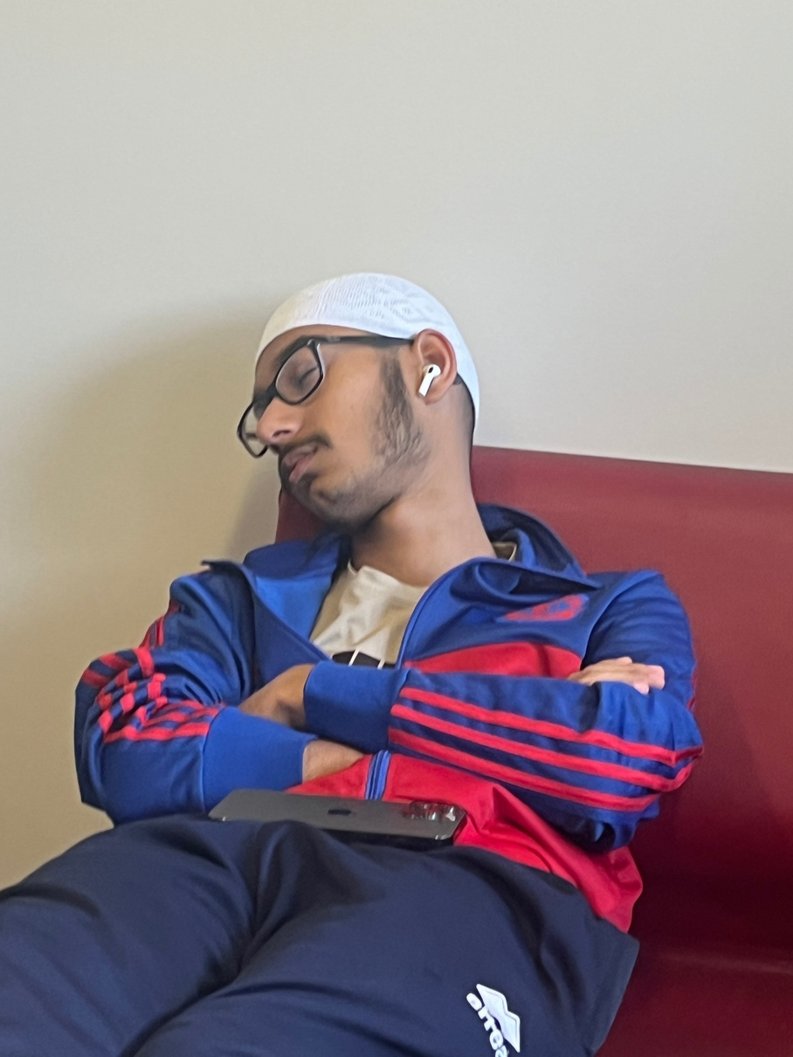
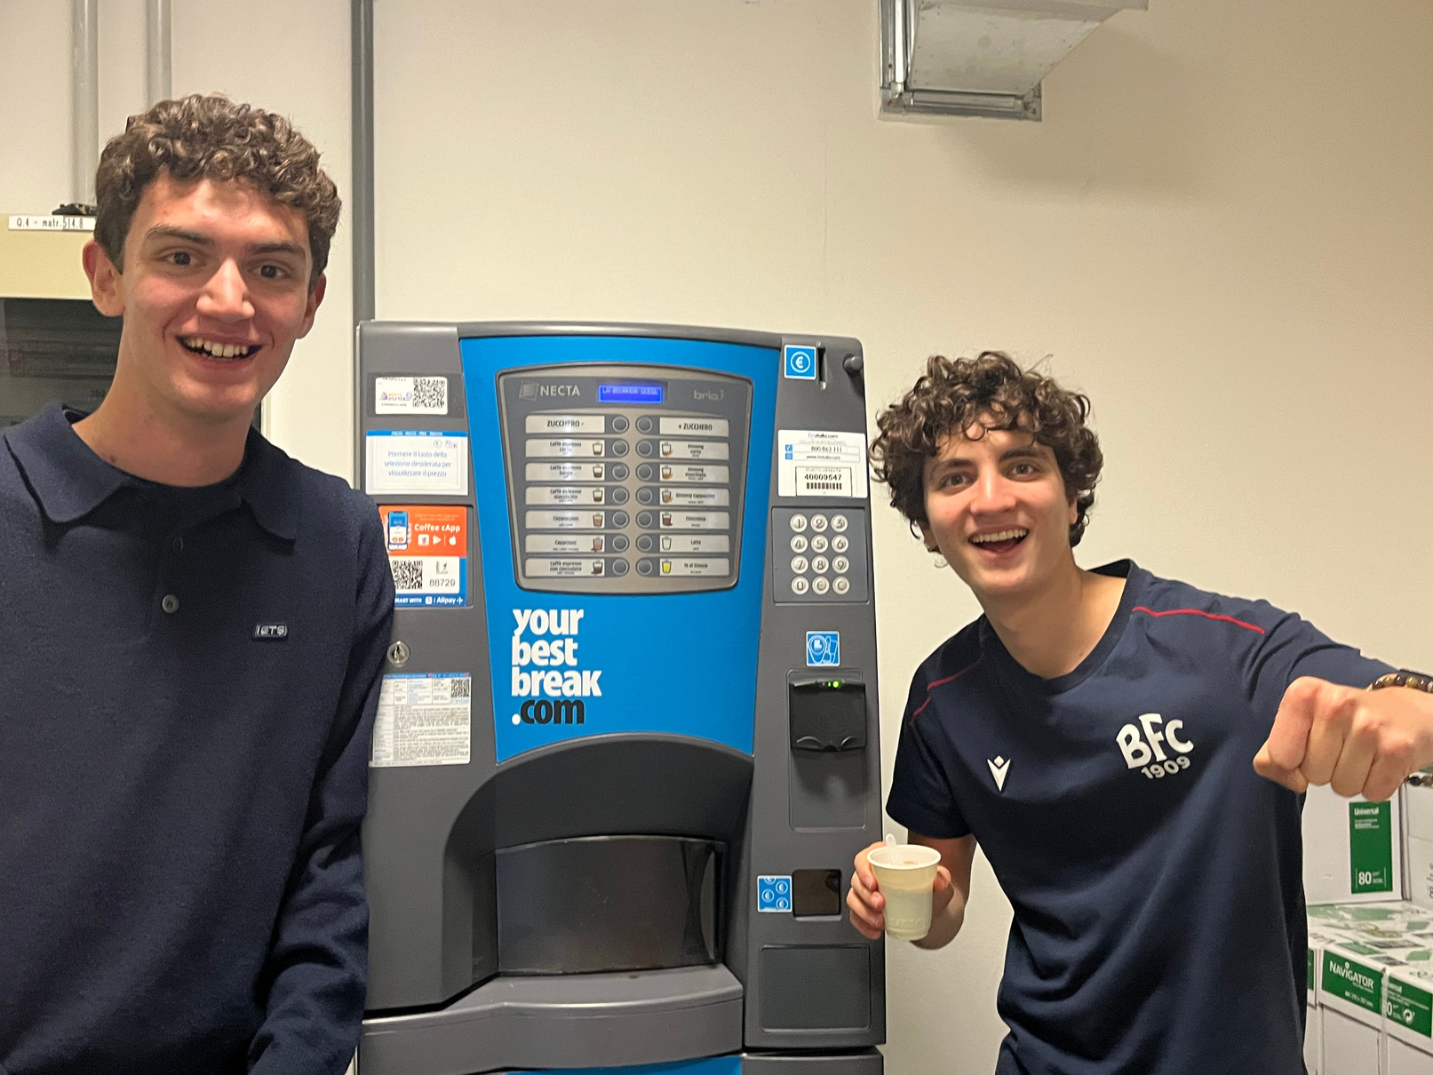
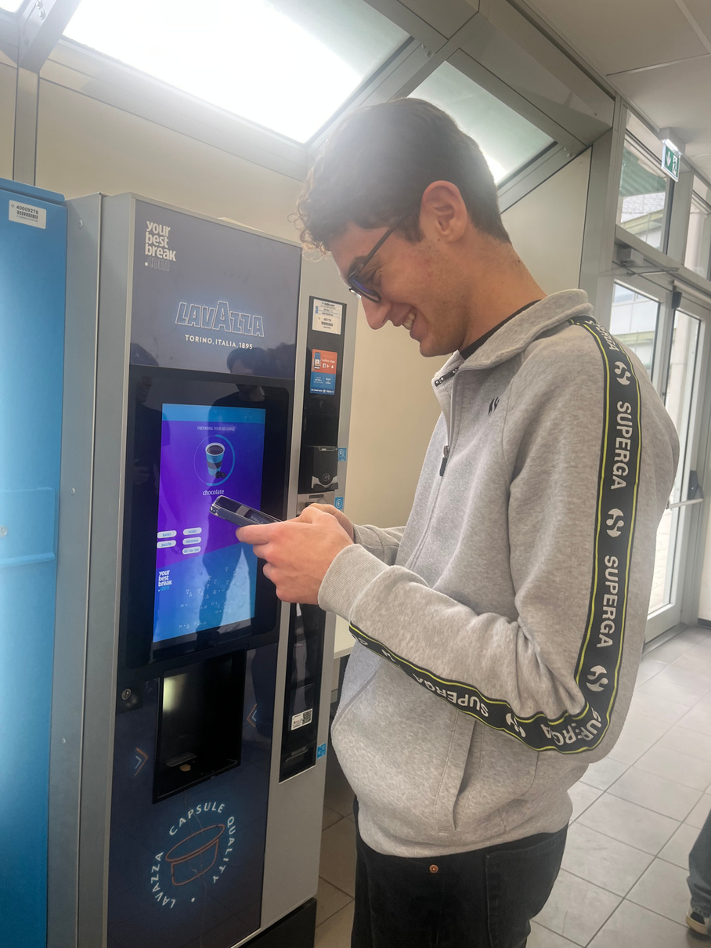
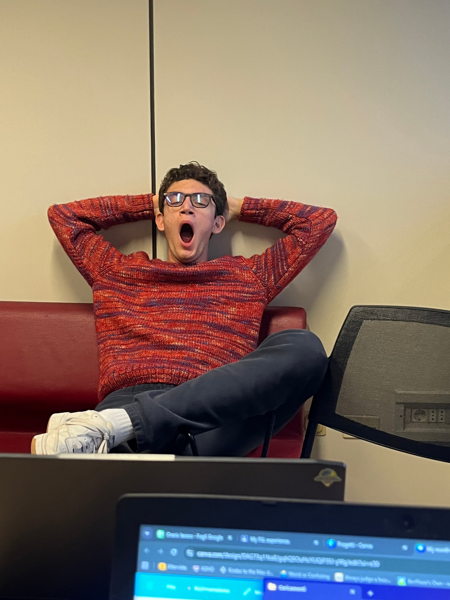
Matteo Galdini
Favorite
Destinations
Sleepy couch
Coffe machine 1
Coffe machine 2

Slide 10
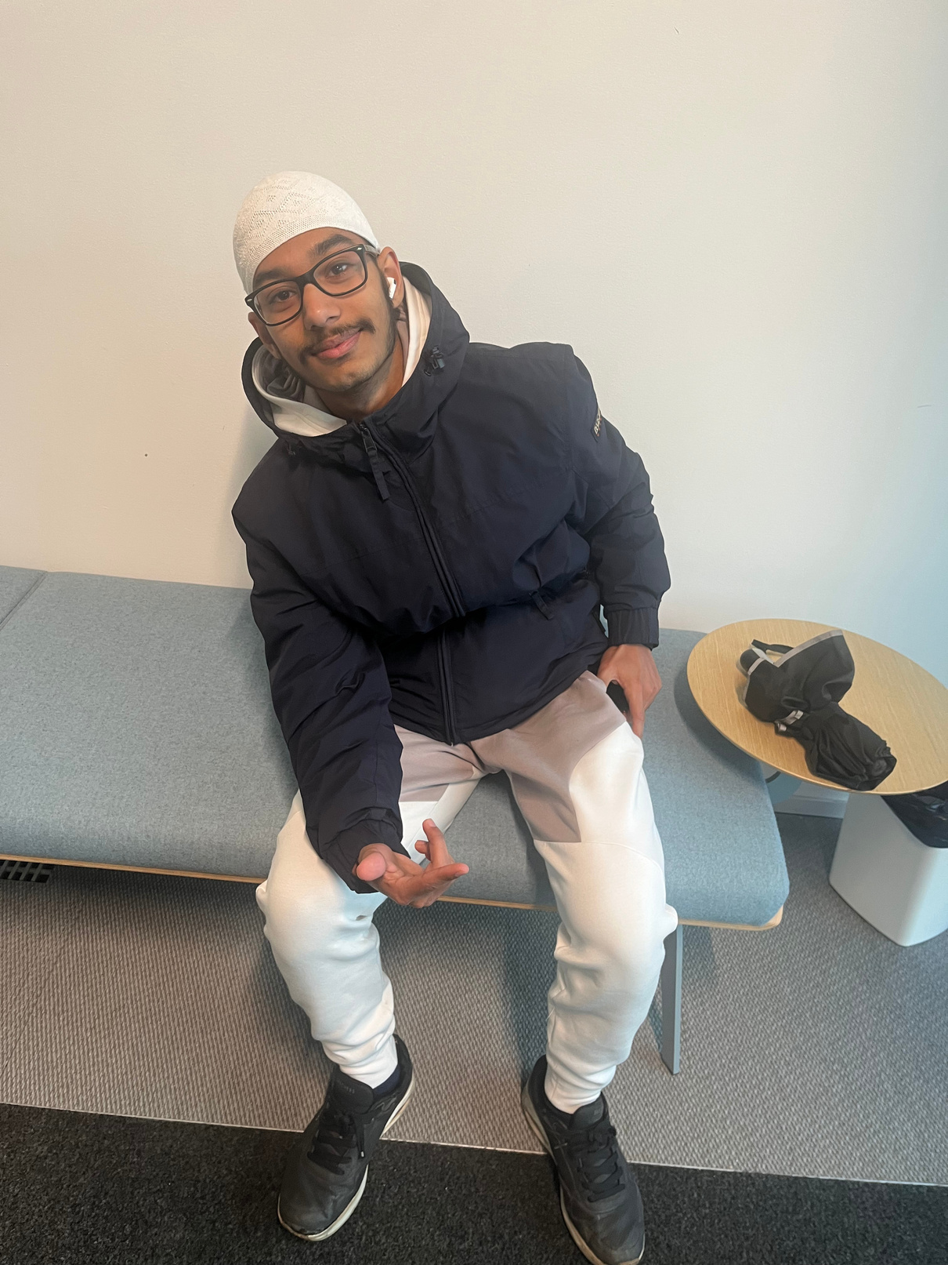
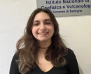

Matteo Galdini
Colleagues
Review
Allegra Di Mattia
Abdul Mohid Butt
Luca Bisognin
My colleague, funny and worked well
Legendary (when he was with us)
Did his job and was funny

Slide 11

Matteo Galdini
Connection
to my
studies
INGV isn’t really connected to my academic studies and future goals
& future
steps
It was useful and funny
Still learned a lot
Great place overall
I still want to go ahed and keep studing
Hopefully one day I’ll be able to pursuit my goal of being a videogame developer, possibily in another country (UK loading.....)

Slide 12
Matteo Galdini
Recomendations &
Gratitude
I’m grateful for the opportunity given to me. I got to team up with serious workers while on the same hands having the priviledge of being near my home.
To anyone who might want to work here, I highly reccommend it, bring your own device.

Slide 13
Matteo Galdini
Thank
you
If you have any questions go ahead and ask!

